Slide 1


The S.O.A.R. Framework
Using AI to fuel the human connection

Slide 2
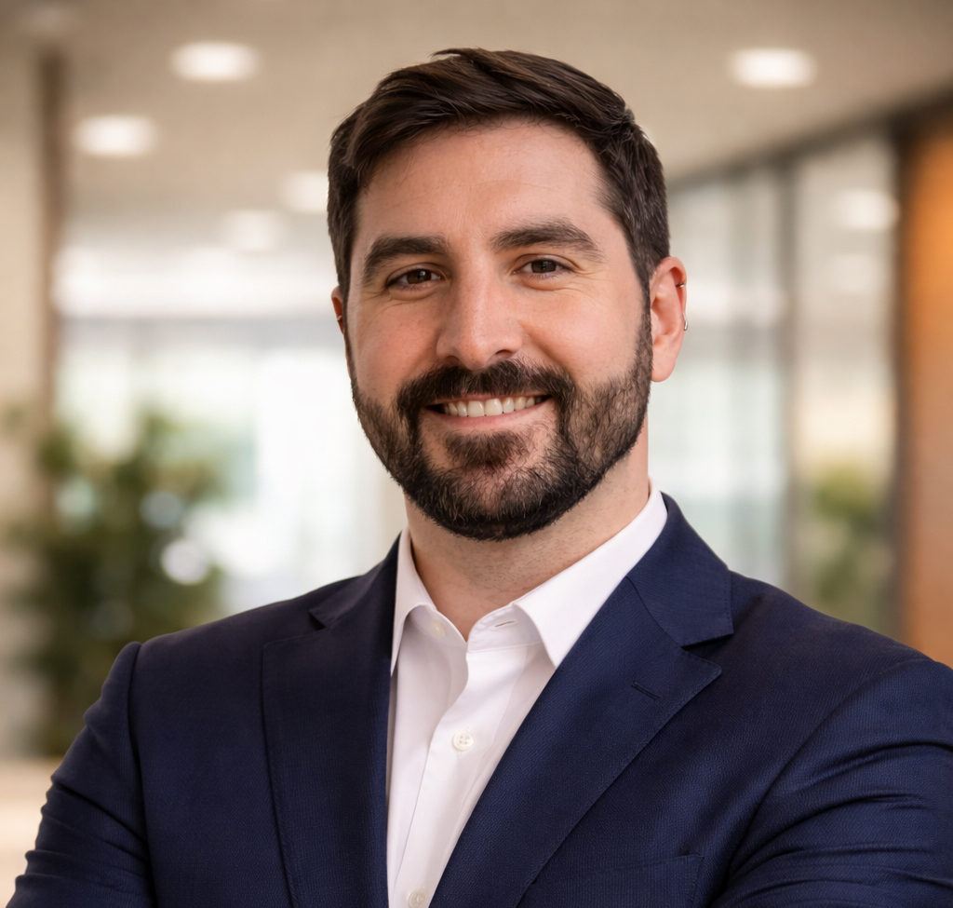

MEET YOUR GUIDE
Caleb Scholze
Sr. Engineering Manager & Consultant, Atiba
Helping business leaders bridge the gap between complex technology and human relationship management.
"AI should be the silent partner that clears your plate, not the robot that replaces your voice."

Slide 3




THE ENERGY AUDIT
Where did you act as a "Data Clerk" last week?
Sorting & Searching
Driving Value
Digging through Gmail, Outlook, or Excel just to find a client's last request.
Consulting, negotiating, and deepening the trust with your partners.

Slide 4







THE S.O.A.R. FRAMEWORK
Source
Orchestrate
Advance
Retain
Intent vs. Guessing
Personalized Scale
Deal Intelligence
Proactive Care

Slide 5
PHASE 1: SOURCE
Stop Searching; Start Finding

Slide 6

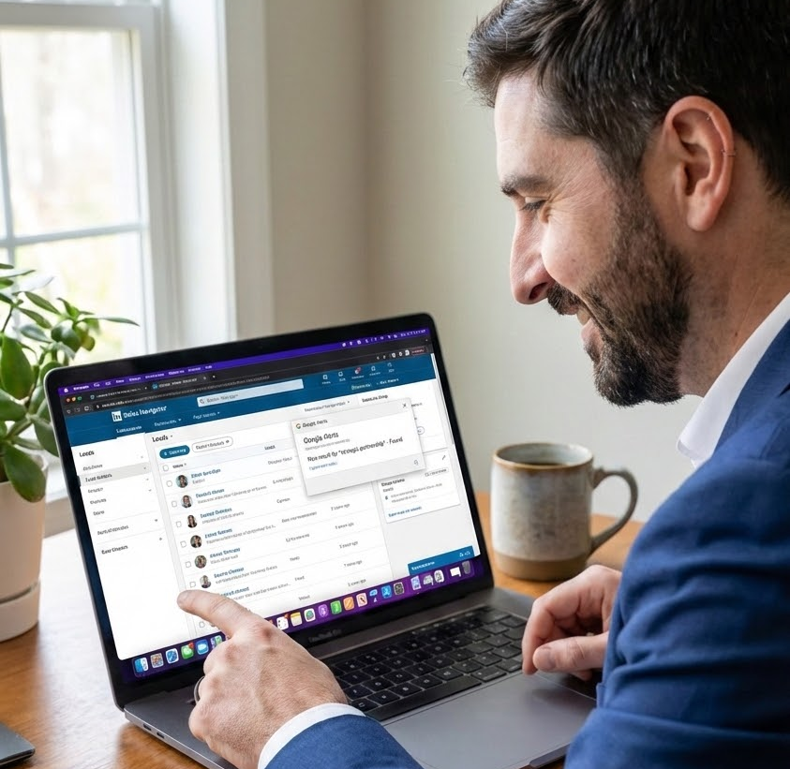

SOURCING WITH INTENT
The Problem: Blind Prospecting
Wasting hours on cold leads who aren't in a "buying window."
The Solution: LinkedIn & Google
Sales Navigator uses AI to flag job changes. Google Alerts monitors for local business growth signals automatically.
"The tools you already have are now 'Signal Detectors.'"

Slide 7
PHASE 2: ORCHESTRATE
Communication at Scale

Slide 8

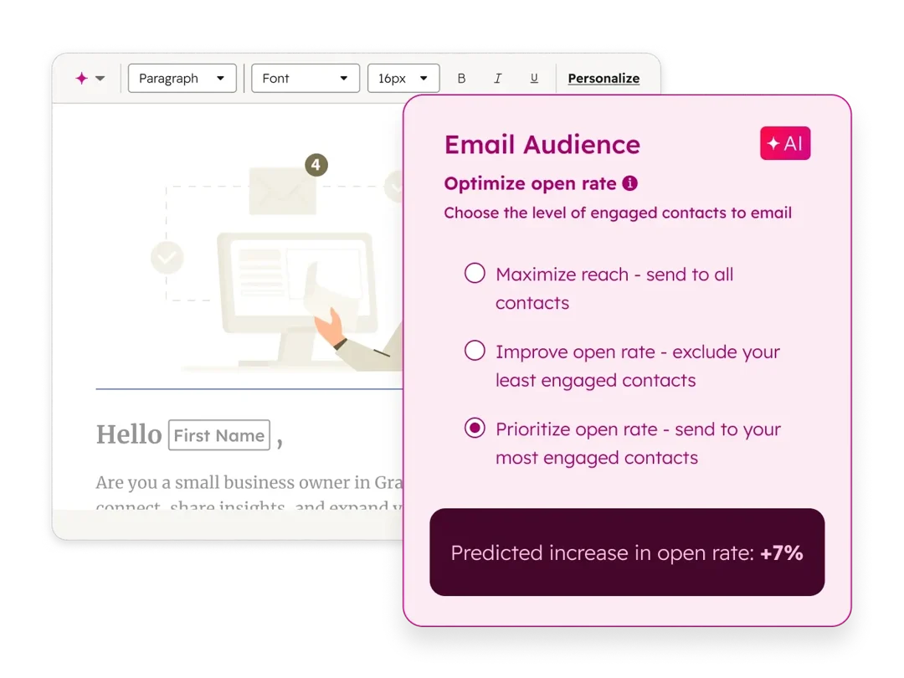

ORCHESTRATE THE "HUMAN" EMAIL
The Problem: Follow-up Fatigue
Valuable leads falling through the cracks because you're too busy to type "personalized" follow-ups.
The Solution: HubSpot & Gemini
HubSpot automates timing. Google Gemini in Gmail drafts contextual replies based on previous email threads.
"Let AI draft the 80% so you can polish the 20% that builds trust."

Slide 9
PHASE 3: ADVANCE
Deal IQ & Negotiation

Slide 10

WINNING THE MEETING
The Problem: Lost Context
Going into a 2nd meeting forgetting the specific pain points mentioned in the 1st.
The Solution: Copilot & Einstein
Microsoft Copilot summarizes Teams recordings in seconds. Salesforce Einstein flags deal health based on engagement.
"Be the most prepared person in the room without spending 5 hours prep-time."

Slide 11
PHASE 4: RETAIN
Proactive Relationship Health

Slide 12
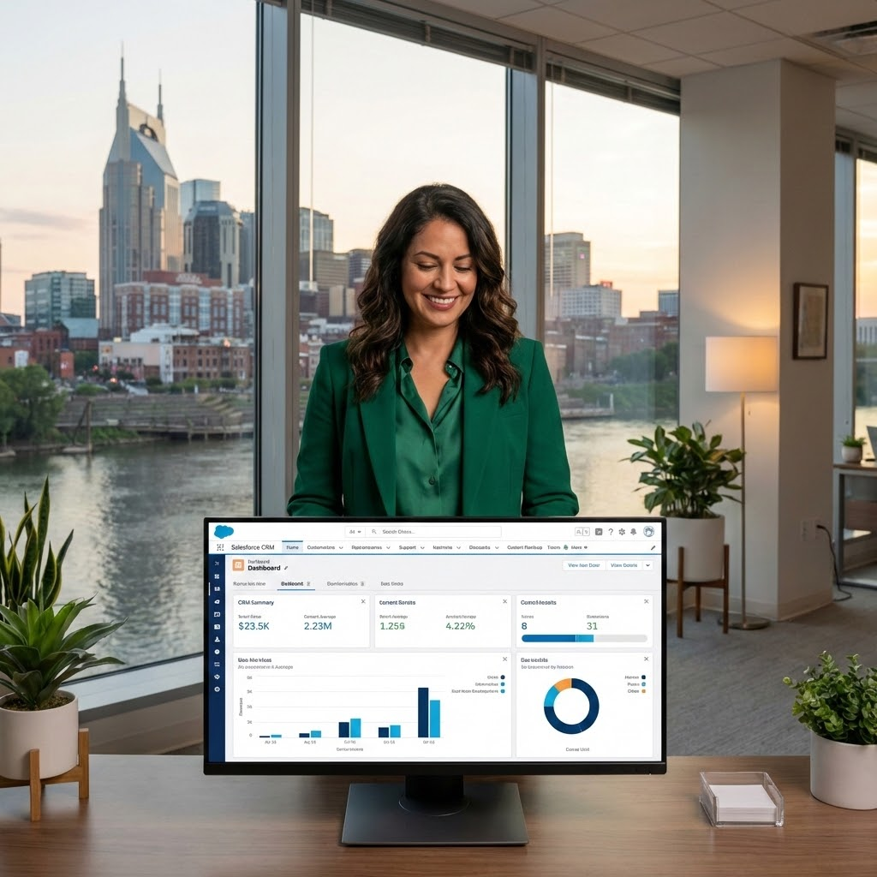
INSTITUTIONAL MEMORY
The Problem: Data Silos
Client information scattered across Google Drive, Salesforce, and text messages.
The Solution: Salesforce & Google
Einstein Activity Capture auto-logs Outlook/Gmail activities. Google Workspace AI summarizes scattered Drive files for a quick pulse check.
"Automation ensures the relationship lives in the CRM, not just your head."

Slide 13


THE BUSINESS ADVANTAGE
You Don't Need "New" Tools
The Shift
The Foundation
The win isn't buying software—it's utilizing AI and technology to eliminate your "Data Clerk" tasks.
Google Workspace, Microsoft 365, and your existing CRM are already AI-enabled.

Slide 14

THE ATIBA CHALLENGE
Spot the Friction: Identify one repetitive task that keeps you from your clients.
Activate the Tech: Find a simple AI feature to handle that administrative heavy lifting.
Fuel the Connection: Use your reclaimed time for a real, human conversation.
Automate the transaction so you can scale the connection.

Slide 15

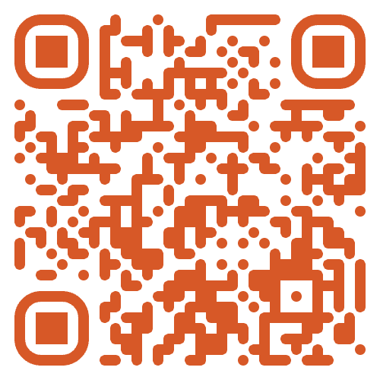
Thank You!
Scan to request your Free 30-Minute Consultation with Atiba.
Includes instant access to the S.O.A.R. One-Pager and the full Presentation Materials.
atiba.com/nashville-chamber-ai

